Slide 1
Heart Disease
Students Name :
Yousef Waiel Zeidan
Yahia Ibrahim Sadaqa
Guided by :
Dr. Mohammad Almseidin
Odai Ahmad Thalji

Slide 2
Contents
Introduction : What , Why , How
Implementation : Features , Preprocessing , ML Model , Results , Conclusion
Reference , Question / Answer , Thanks

Slide 3
Introduction
What :
In this presentation, we will be discussing our project on using
ML Model to predict heart disease.
We used ML model to build a model that predicts heart disease using the language of python.

Slide 4
Introduction
Why :
The prediction of heart disease has significant implications and benefits. It enables early detection and prevention of disease by identifying at-risk individuals before symptoms appear. Artificial intelligence is used in cardiology to enhance decision support. AI models can provide decision support to healthcare professionals by analyzing complex data and creating predictions or risk assessments. This model assists clinicians in making informed decisions regarding prognosis, treatment plans, and patient management strategies.

Slide 5
Introduction
How :
We collected a comprehensive dataset on cardiac patients and applied machine learning algorithms to train a predictive model. The model was evaluated using various performance measures and achieved an accuracy of 92%. Our findings reveal significant associations between identified risk factors and the incidence of heart disease.
We used a cardiology dataset, then pre-processed such as handling outliers, processed null values, and did data transformation, and finally converted the target value into binary classes.

Slide 6
Implementation
Features
Age
Gender
CP
Trestbps
Chol
FBS
Restecg
Thalch
Exange
Oldpeak
Thal
Class

Slide 7
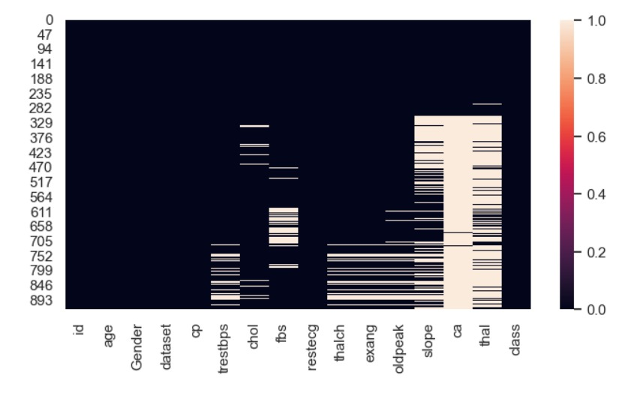
Preprocessing
Handling null value :-
We used “heatmap” to identify the number of null values in each feature.
Some features had to be excluded from the experiment.
The missing values for the remaining features were filled using advanced technique which is
“ Group by Mean, Median, Mode “.

Slide 8
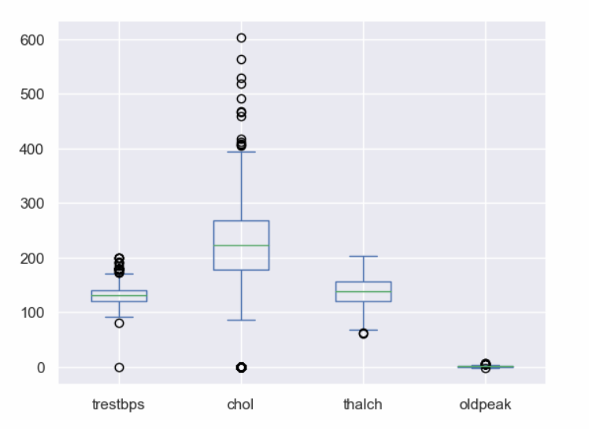
Handling outliers
To maintain the results of the model we moved the outliers to upper and lower fence

Slide 9
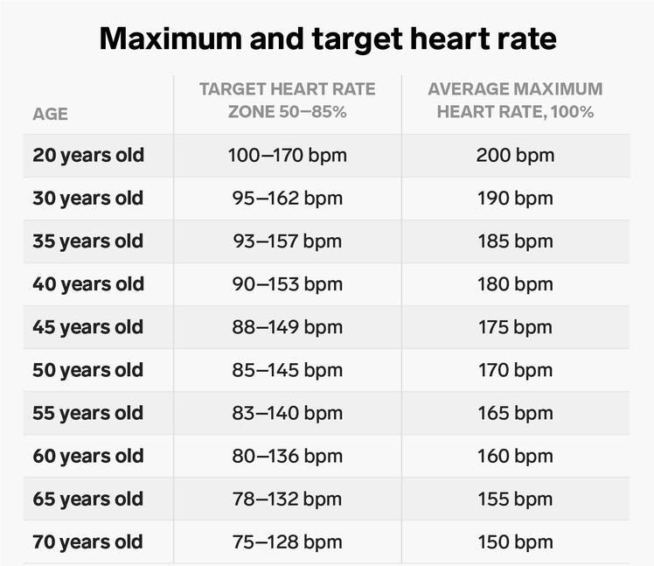
Transformation
targeted data in this step is categorical data to transform it to be ready for use in a machine learning model.
According to medical researchers, the study of heart rate depends on age.
In our project we did a transformation process from age to category data.

Slide 10
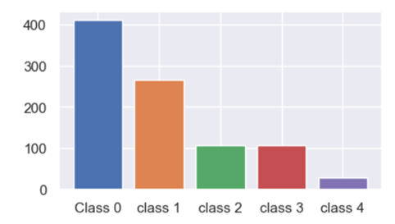
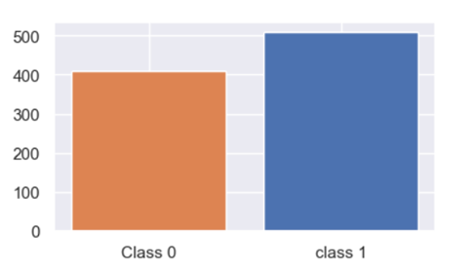
Processing in class
Before Transformation :
0 = no heart disease.
1, 2, 3, 4 = stages of heart disease.
After Transformation :
0 = no heart disease.
1 = suffers heart disease.

Slide 11
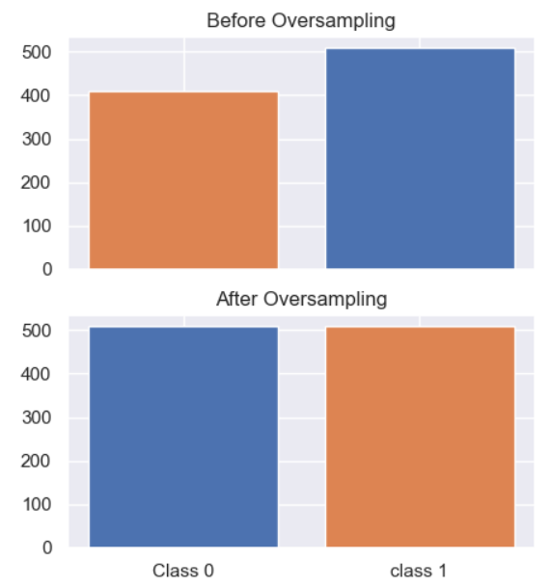
ML Model
1. We applied a technique called “ over sampling ” to make the data balanced
2. We scaled the data to ensure the accuracy and efficiency of the training and to facilitate a proper interpretation and comparison of the model .
3. we have applied K – cross validation
for splitting the data.
4. Finally, we tested the data using many
ML models

Slide 12
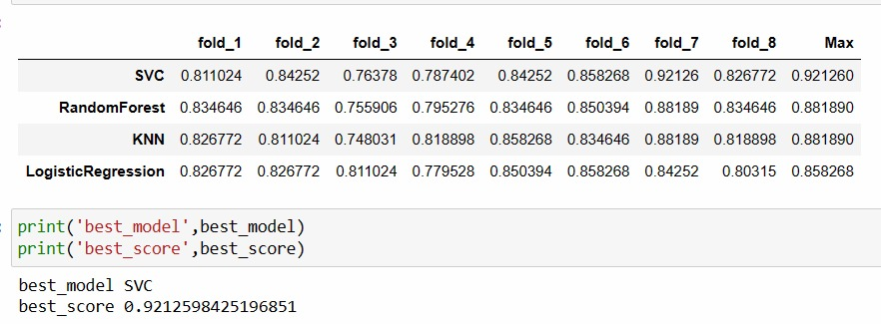
Results
According to this figure we compared the results of each model and noticed that the SVM had the best results.

Slide 13
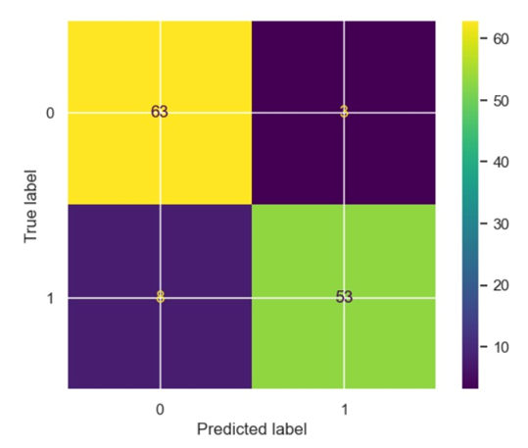
Confusion matrix

Slide 14
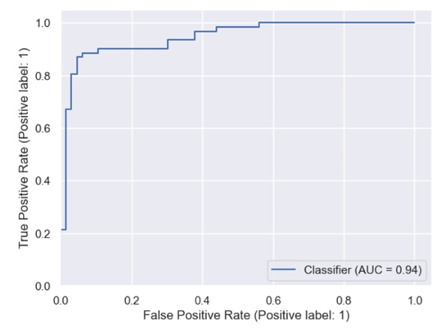
ROC

Slide 15
Conclusion
To conclude , our project focused on pre-processing the dataset and classifying it into different models using K-cross validation.
The result was that the Support Vector Machine model had the best results.

Slide 16
Question / Answer

Slide 17
Reference
Sony, Md. R. K. (2020, September 23). UCI Heart Disease Data. Kaggle.
https://www.kaggle.com/datasets/redwankarimsony/heart-disease-data

Slide 18
Thanks

